Slide 1



POINT PREVALANCE SURVEY ON ANTIBIOTIC USE AND HOSPITAL ACQUIRED INFECTIONS CONDUCTED AT KENYATTA UNIVERSITY TEACHING RESEARCH AND REFERRAL HOSPITAL
Head Shot
CAROLINE MWANGI, IPC MANAGER, KUTRRH

Slide 2
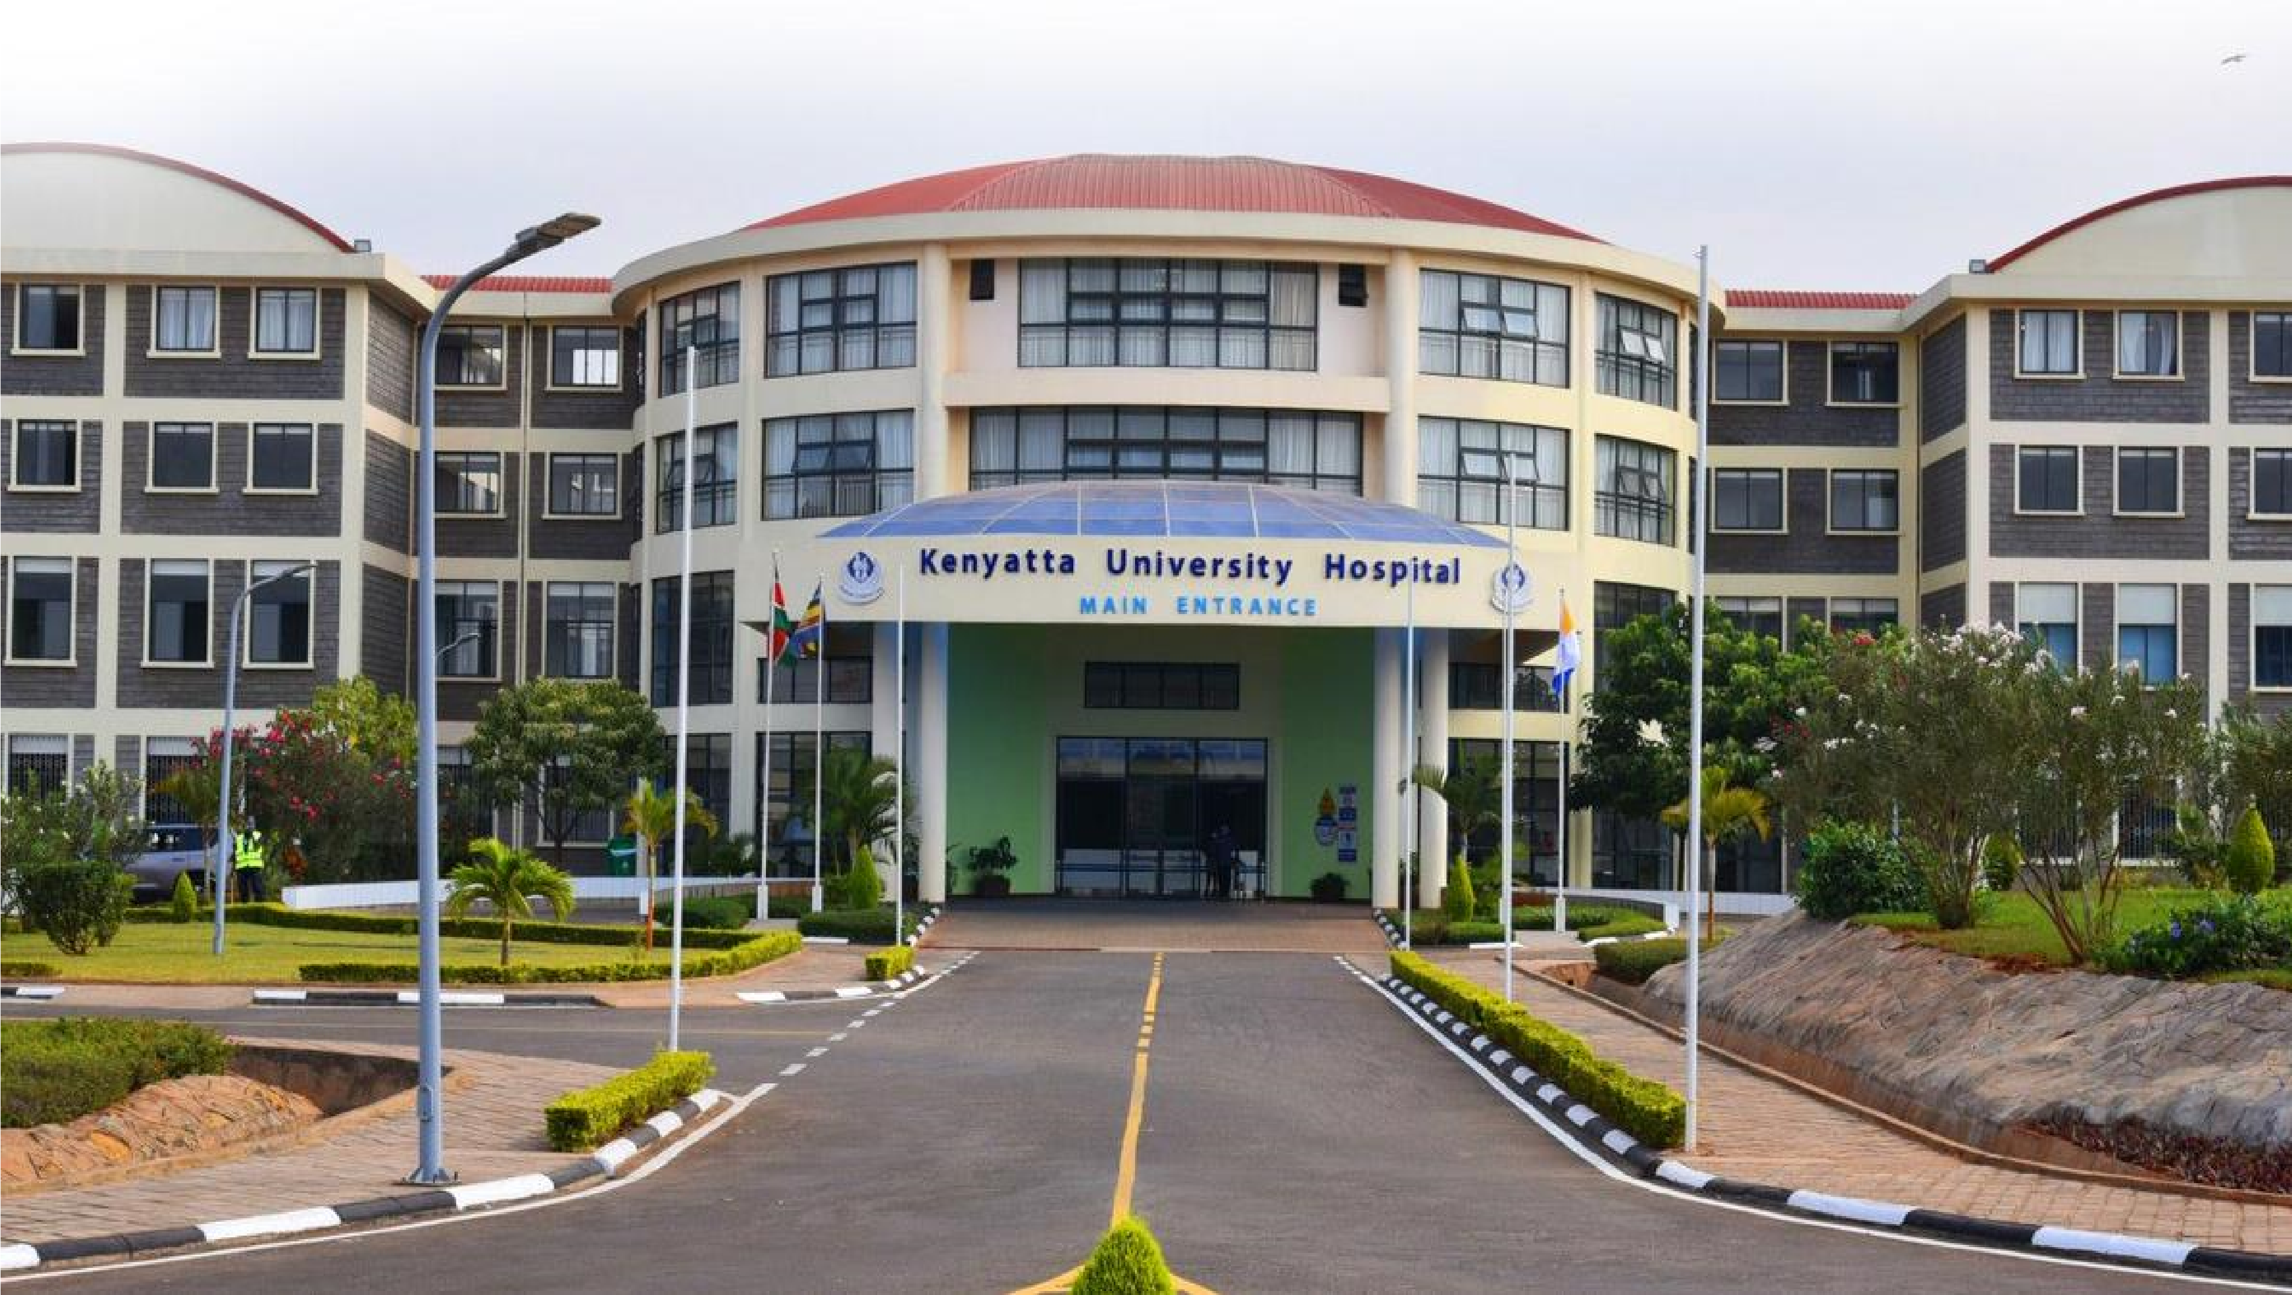
BACKGROUND
•
KUTRRH is one of three regional referral
hospitals located in Nairobi County, Kenya.The
Hospital has a bed capacity of 650 with
62
intensive care unit beds, and serves
approximately 3200 outpatients per month ,
the majority attending specialized clinics.
East Africa IPC Community of Practice

Slide 3
INTRODUCTION
AMR is a growing global health threat that makes treating infections, especially those linked to healthcare settings, more difficult.
These HAIs often lead to longer hospital stays and higher mortality.
Monitoring patterns of antibiotic use and HAIs helps identify opportunities to optimize antibiotic use, reducing the development of AMR, and introduce interventions to prevent HAIs.
This study aimed to estimate the prevalence of AMU and HAI and evaluate laboratory diagnostic utilization at KUTRRH

Slide 4
Survey objectives
Primary Objectives
Antimicrobial use (AMU)
To estimate antimicrobial use prevalence in hospitalized patients
To describe the antibiotics used and their indication.
To assess the use of laboratory diagnostic services to support antibiotic prescribing for hospitalized patients.
Healthcare Associated Infection (HAI)
To estimate the prevalence of healthcare associated infections in hospitalized patients
To describe healthcare associated infections found in hospitalized patients.
To assess the use of laboratory diagnostic services to identify healthcare associated infections.

Slide 5
Survey methodology
A cross-sectional study design was used adapting the European Centers for Disease Control point prevalence survey (ECDC PPS) protocol 6.1,
WHO AMU PPS tool, Global PPS and Global Action in Health Network – Healthcare Associated Infection point prevalence survey protocol (GAIHN-HAI) methodologies.
The reference survey date was the 2nd of October 2023, with the data collection being conducted between 2nd October 2023 to 24th October 2023.

Slide 6
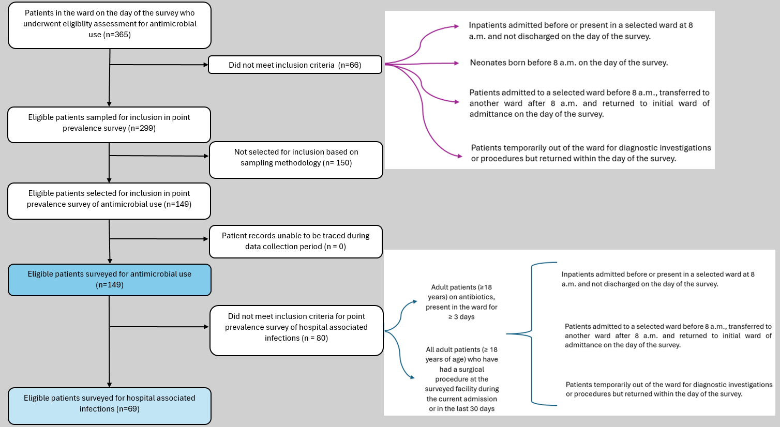

Slide 7
Antimicrobial stewardship, Infection prevention and control and Drugs and Therapeutics programs
- The hospital has an administration recognized AMS committee that had met in the last 6 months prior to the survey date, that boasts of being led by a Physician and having a Pharmacist as part of the committee.
- The program has dedicated staff available for supporting clinical decisions surrounding antimicrobial use, including information technology support for antibiotic stewardship activities.
- The hospital has both IPC and drugs and therapeutics committees that had met in the last 6 months prior to the survey date.
- Current/updated Essential drugs list was not available in the wards.

Slide 8
Antimicrobial stewardship activities
-The facility does have formal guidelines to assist with empirical decisions on antibiotic use, and a policy requiring prescribers to provide rationale for prescribing antibiotics.
- The facility audits and reviews surgical antimicrobial prophylaxis.
- Training had not been provided regarding local antibiotic resistance patterns and concerns in the last 12 months prior to the survey.
- Results of antimicrobial audits or reviews were not being communicated directly with prescribers.

Slide 9
Laboratory support for microbiological investigations
- The facility has a clinical microbiology laboratory that has the necessary bacterial culture and antibiotic susceptibility testing reagents/materials.
- For the period 3 months prior to the survey the facility conducted 1081 bacterial cultures and 886 antibiotic susceptibility tests.
- The microbiology lab is served by medical lab technologists.

Slide 10
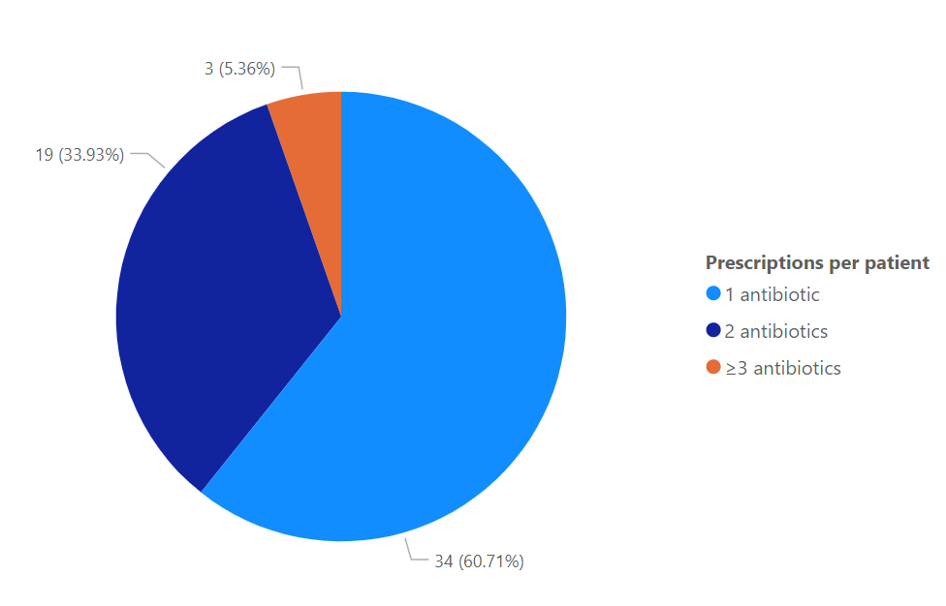
Antibiotic use cont.

Slide 11
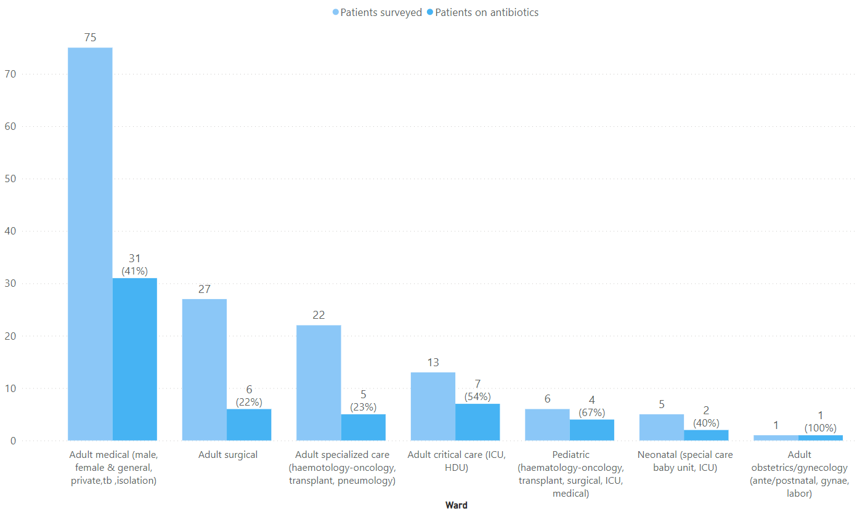
Antibiotic use across different wards

Slide 12
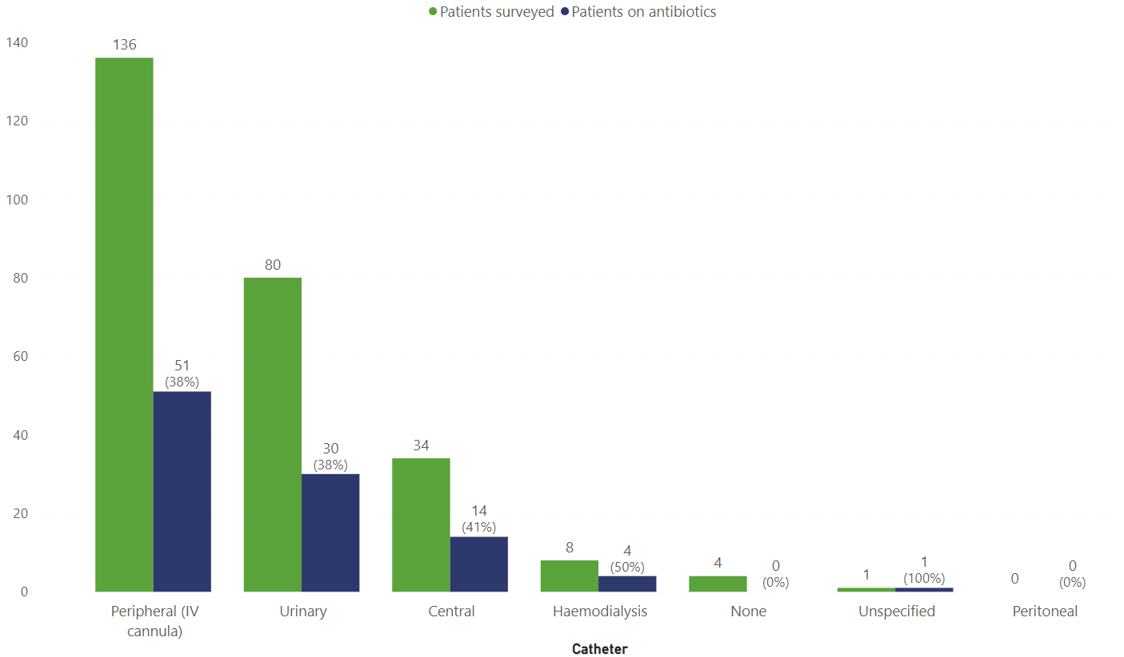
Antibiotic use in relation to catheter use

Slide 13
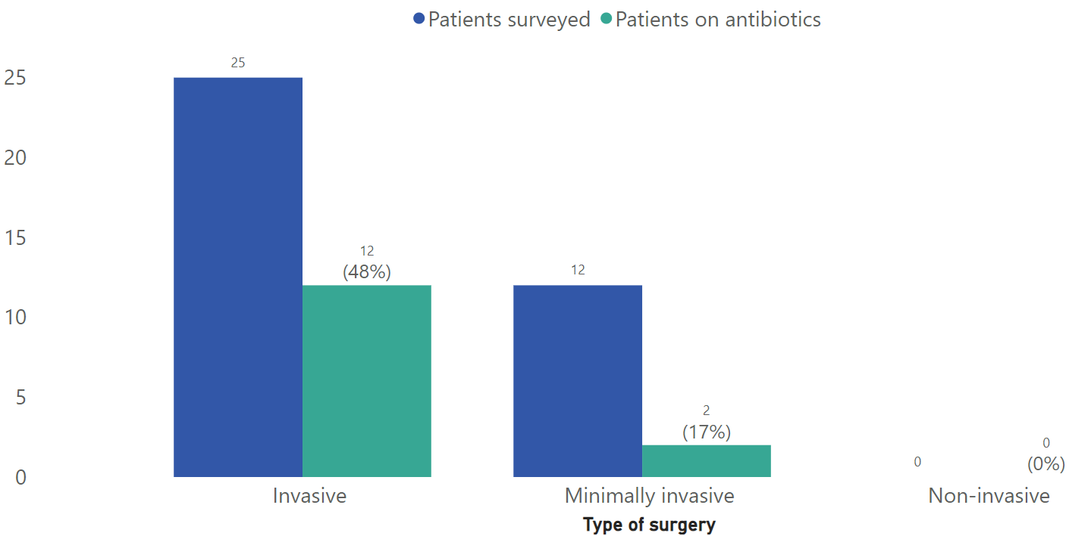
Antibiotic use in relation to types of surgery

Slide 14
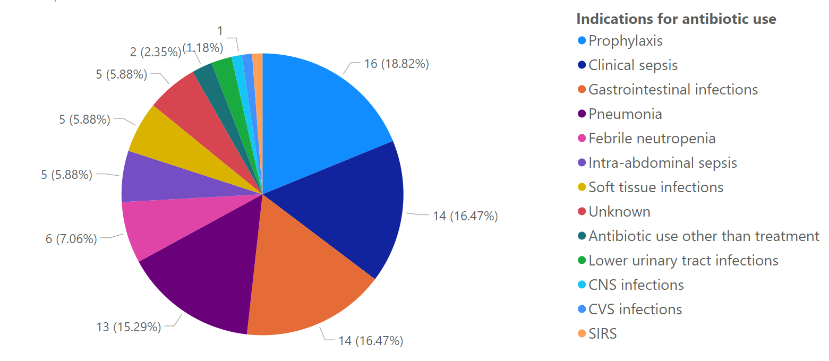
Indications for antibiotic use

Slide 15
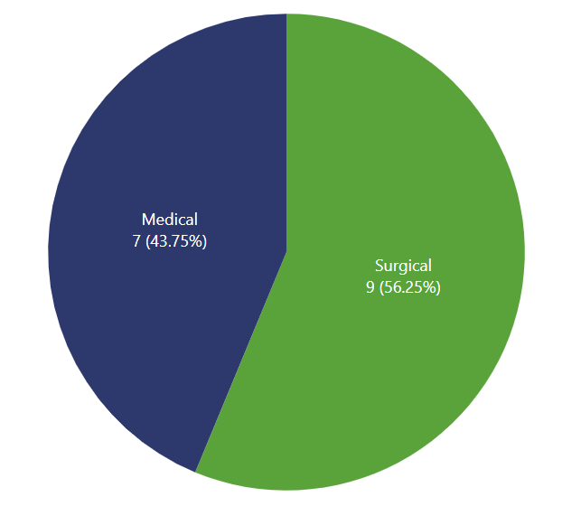
Indications for prophylaxis

Slide 16
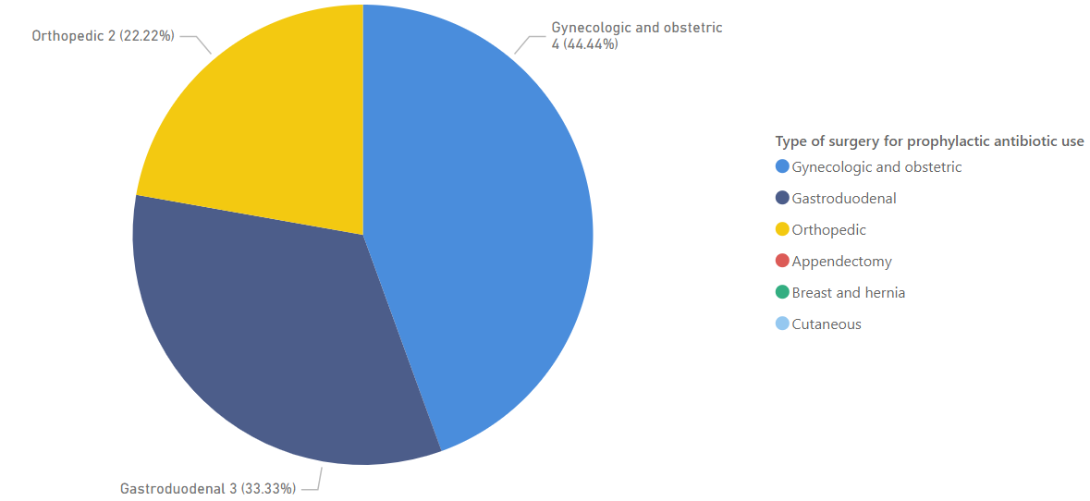
Surgical indications for prophylactic antibiotic use

Slide 17
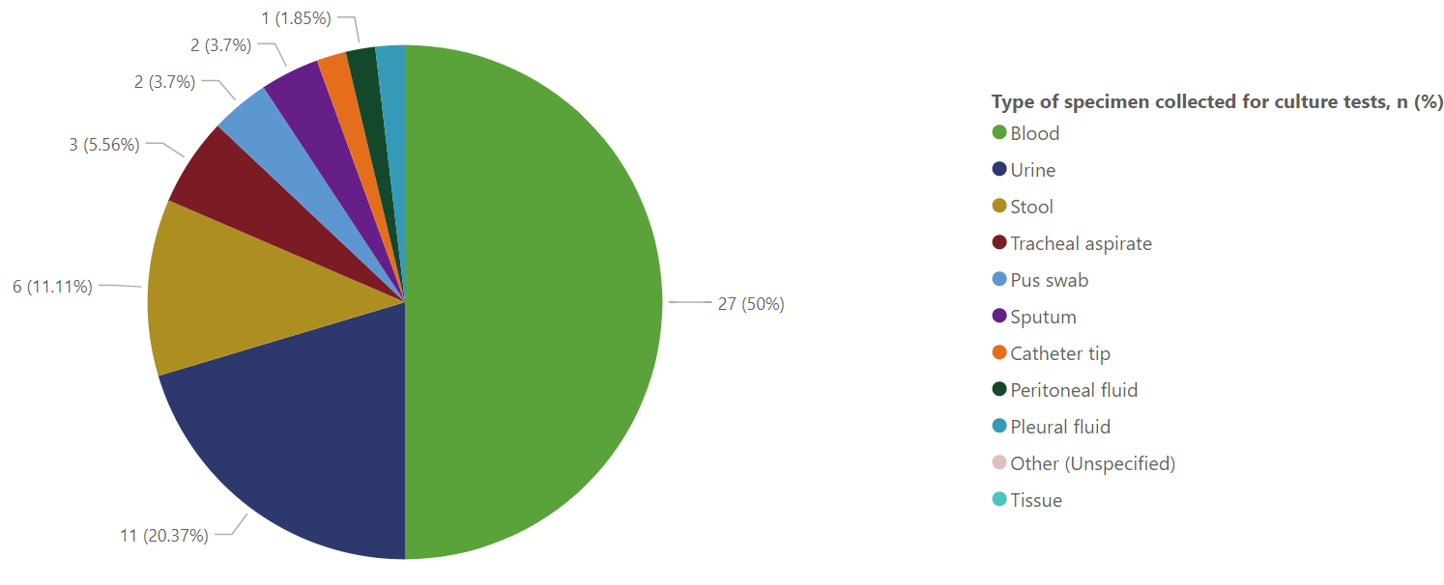
Culture tests done

Slide 18
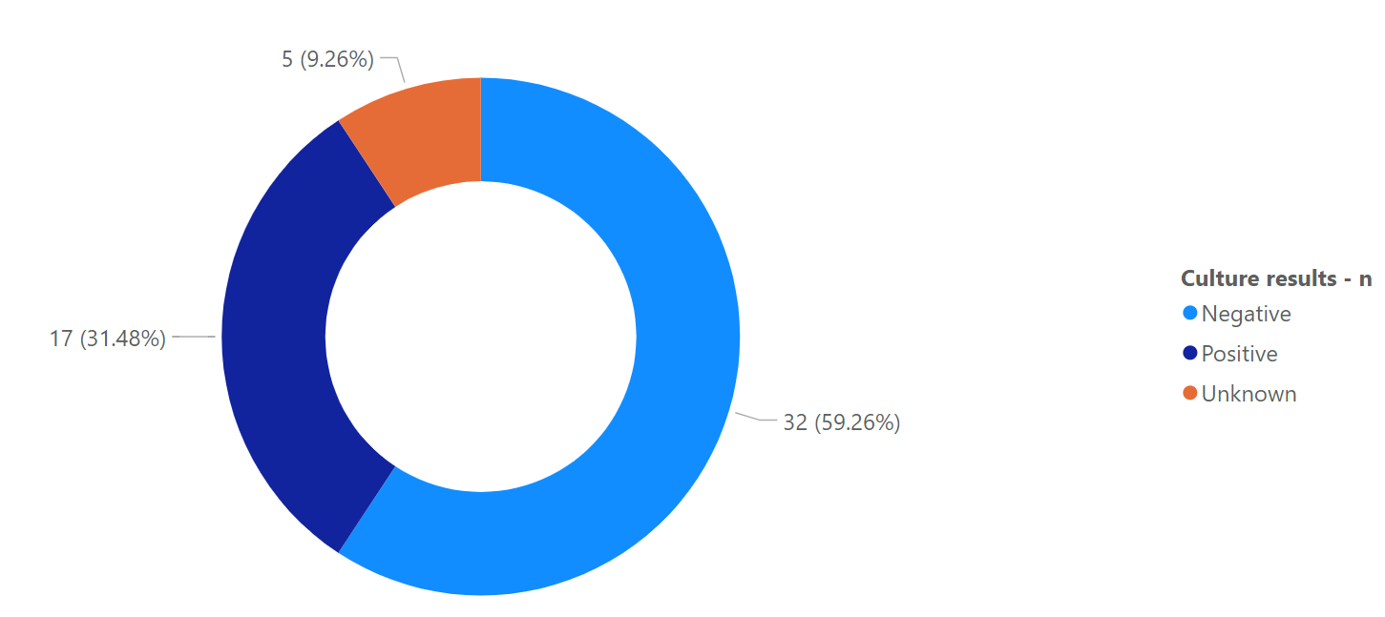
Culture tests results

Slide 19
Healthcare associated infections
Hospital | Total no. of inpatients surveyed for AMU¹ | Total no. of adult inpatients surveyed for AMU and "at risk" for HAI | Patients for UTI determination | Patients for BSI determination | Patients for pneumonia determination | Patients for SSI determination
 | n | n | n | n | n | n
Kenyatta University Teaching Research and Referral Hospital (KUTRRH) | 149 | 135 | 31 | 44 | 19 | 34
Patients <18 years=14
UTI-Urinary tract infection
BSI-Blood stream infection
SSI- Surgical site infection

Slide 20
Healthcare associated infections cont.
Hospital |  | Any infection | Pneumonia | Surgical-site infection | Bloodstream infection | Urinary tract infection
 | N | n (%) [95% CI] | n (%) [95% CI] | n (%) [95% CI] | n (%) [95% CI] | n (%) [95% CI]
Kenyatta University Teaching Research and Referral Hospital (KUTRRH) | 135 | 11 (8.1%) [4.1 - 14.1] | 1 (0.7%) [0.02 - 4.1] | 6 (4.4%) [1.6 - 9.4] | 4 (3.0%) [0.81 - 7.4] | 2 (1.5%) [1.8 - 5.2]

Slide 21
CONCLUSION
Findings indicate high antibiotic use, and presence of HAIs especially SSIs
This underscores the need for strengthened AMS-IPC collaboration, improved feedback loops for antimicrobial audits, and enhanced use of diagnostic data to guide antibiotic therapy.

Slide 22


THANK YOU
Acknowledgment

